Slide 1

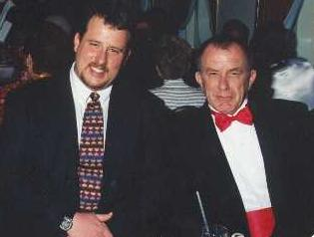
Exposure CS 2022
for CS1
Chapter 9 Section 7-11 Slides
Modular Programming: Creating
Procedures & Functions with Parameters
PowerPoint Presentation
created by:
Mr. John L. M. Schram
and Mr. Leon Schram
Authors of Exposure
Computer Science

Slide 2
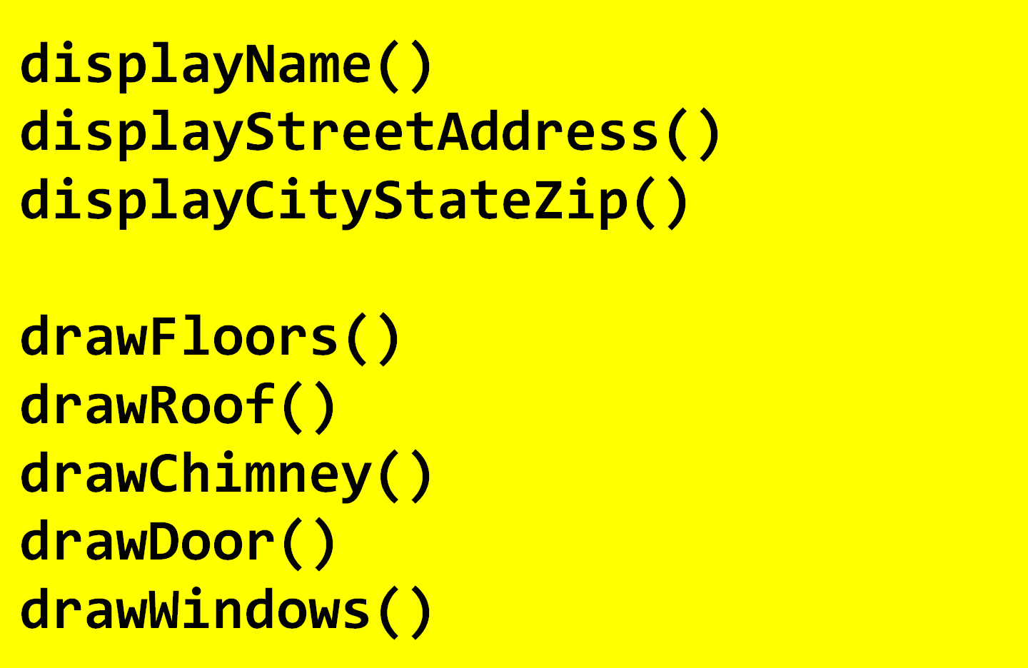
Subroutine Calls Without Arguments

Slide 3
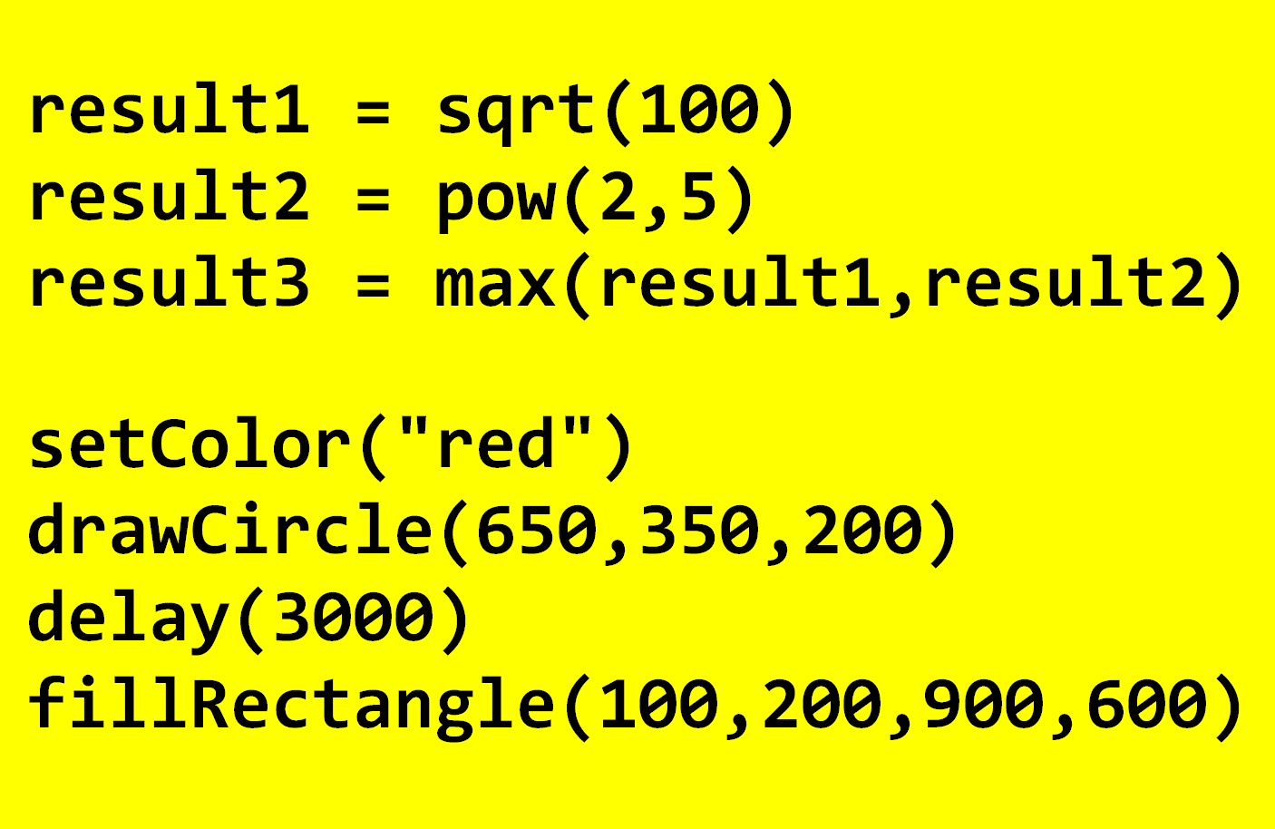
Subroutine Calls With Arguments

Slide 4
Section 9.7
Procedures with a Single
Argument & Parameter

Slide 5
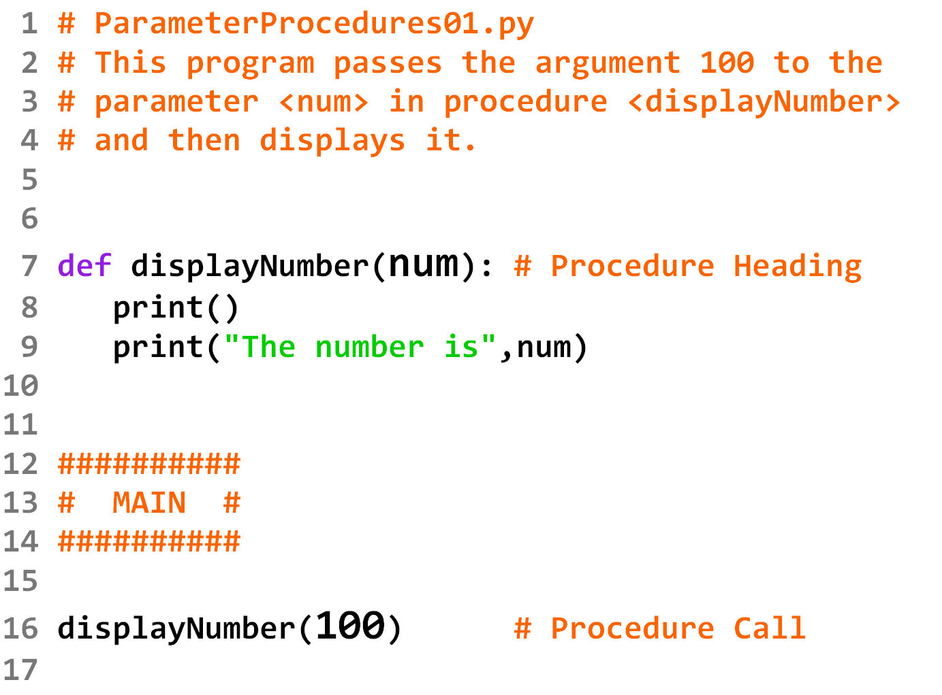

Slide 6
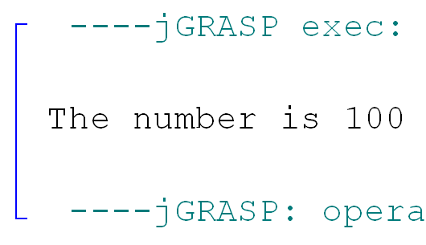

Slide 7
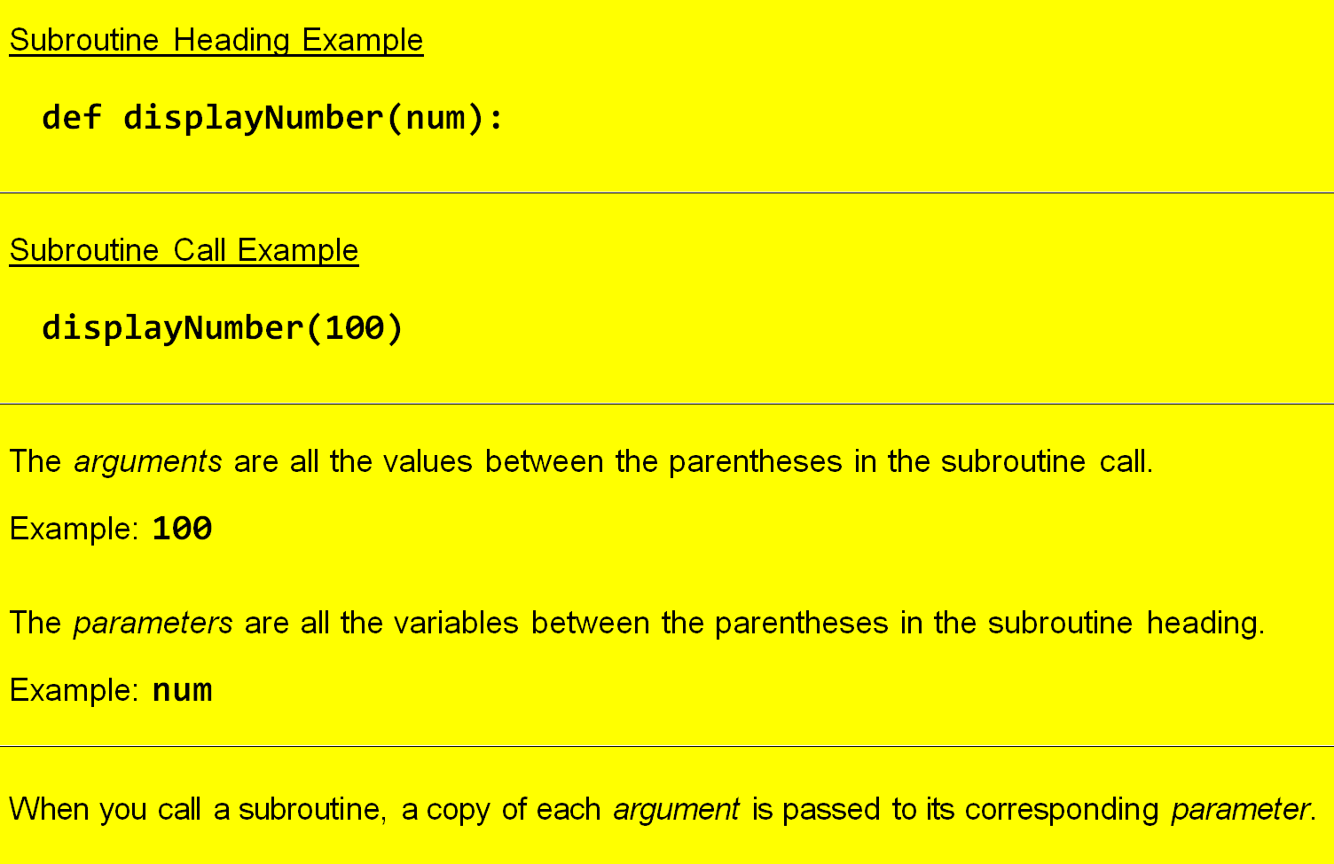
Arguments vs. Parameters

Slide 8

Argument/Parameter Disclaimer
If you learned another programming language before taking this course, you may have learned about Actual Parameters in the subroutine call and Formal Parameters in the subroutine heading. For the sake of this course, and to be consistent with the terminology used on the PCEP Certification Exam, just do the following translation in your head:
Other Languages | Python
Actual Parameters | Arguments
Formal Parameters | Parameters

Slide 9
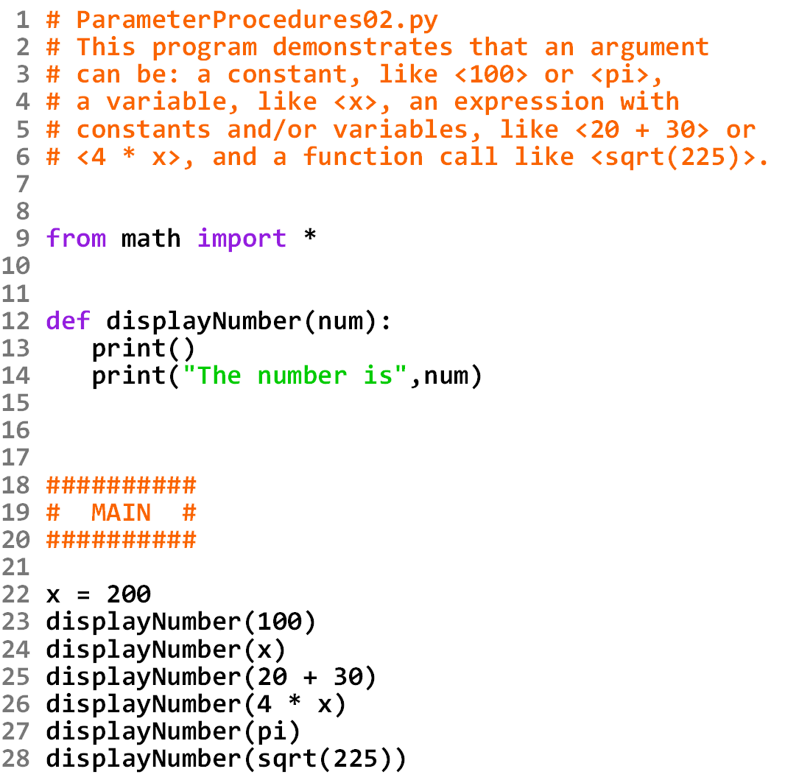

Slide 10
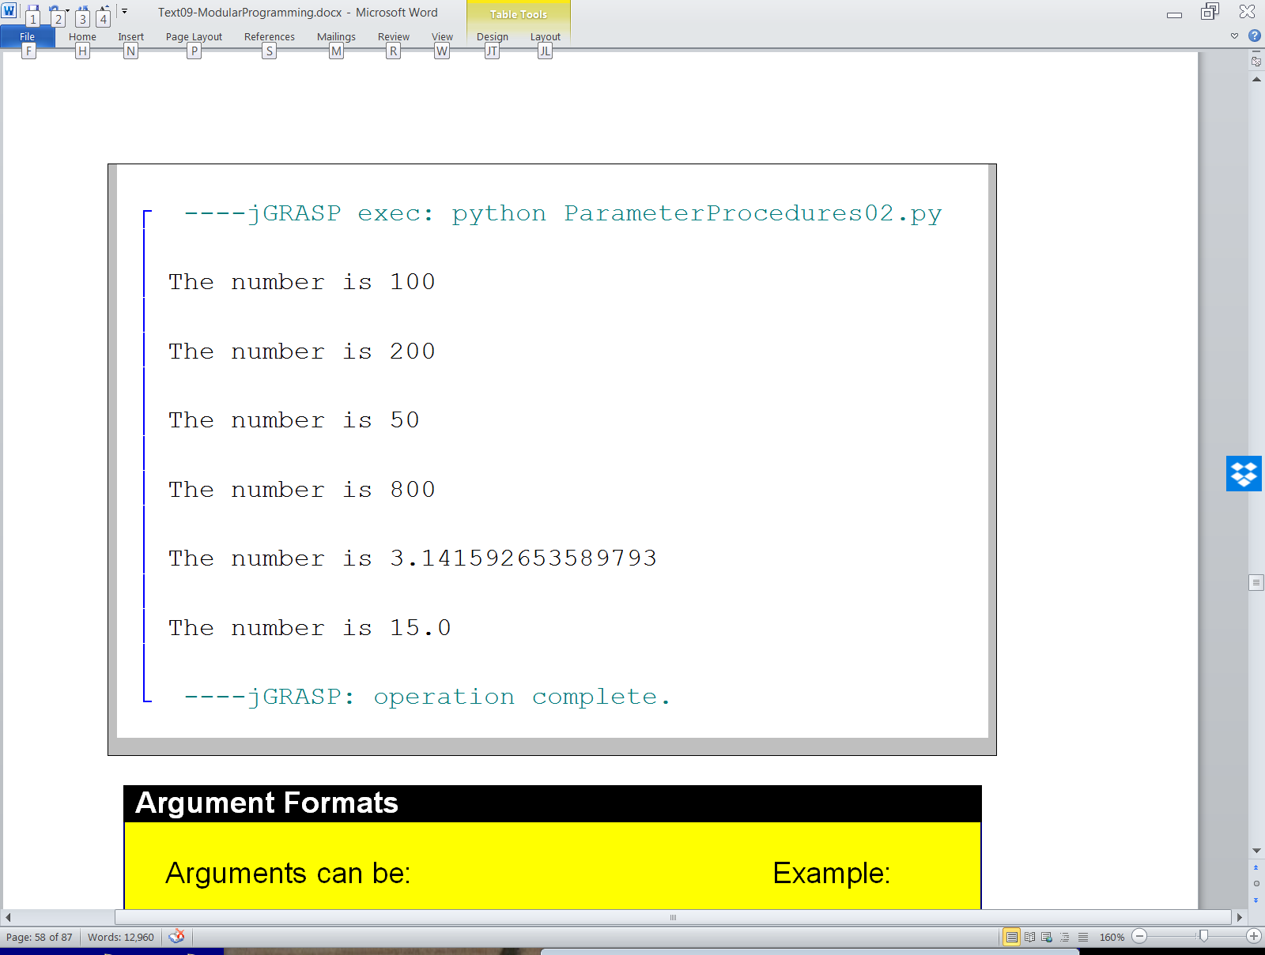

Slide 11
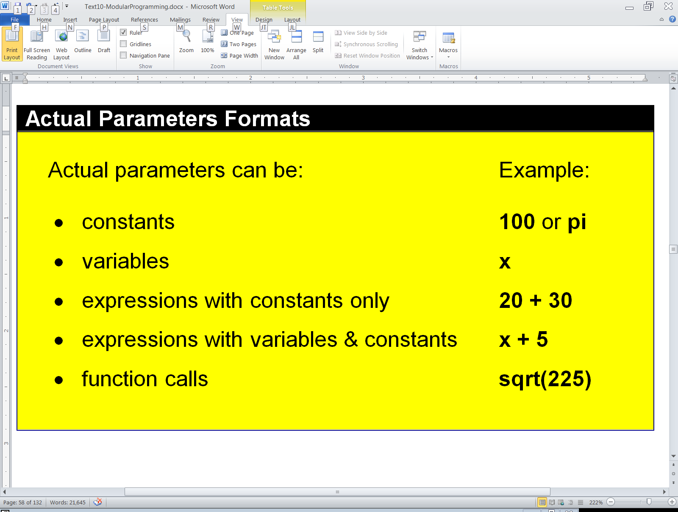
Argument Formats
Arguments can be

Slide 12

The Football Analogy
The Quarterback - The Argument
The Football - A copy of the data
The argument passes a copy of the data to the parameter.
The Receiver - The Parameter
displayNumber(x)
200
def displayNumber(num):

Slide 13
The Football Analogy
The Quarterback - The Argument
The Football - A copy of the data
The argument passes a copy of the data to the parameter.
The Receiver - The Parameter
displayNumber(x)
200
def displayNumber(num):

Slide 14
Section 9.8
Procedures with Multiple
Arguments & Parameters

Slide 15
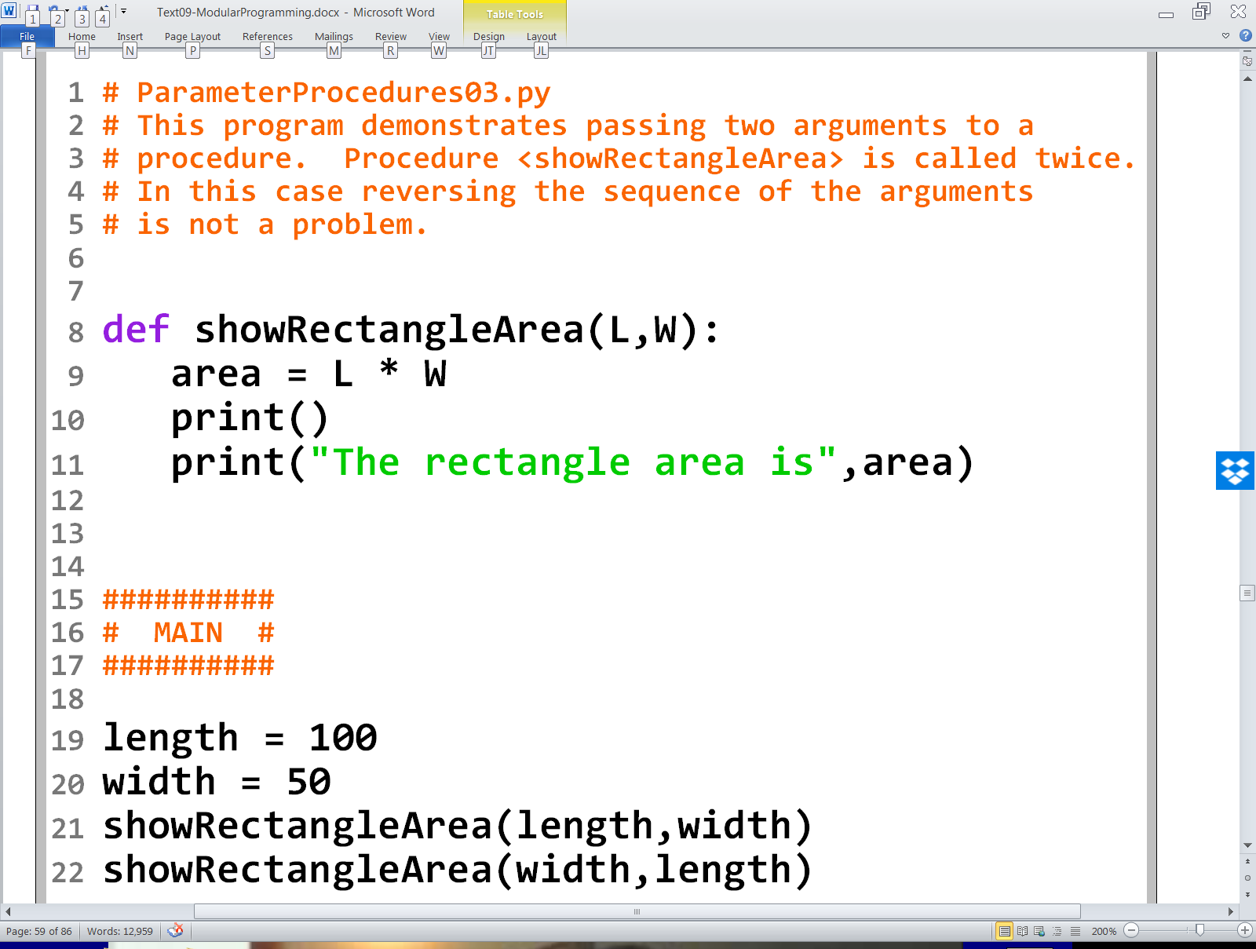


Slide 16
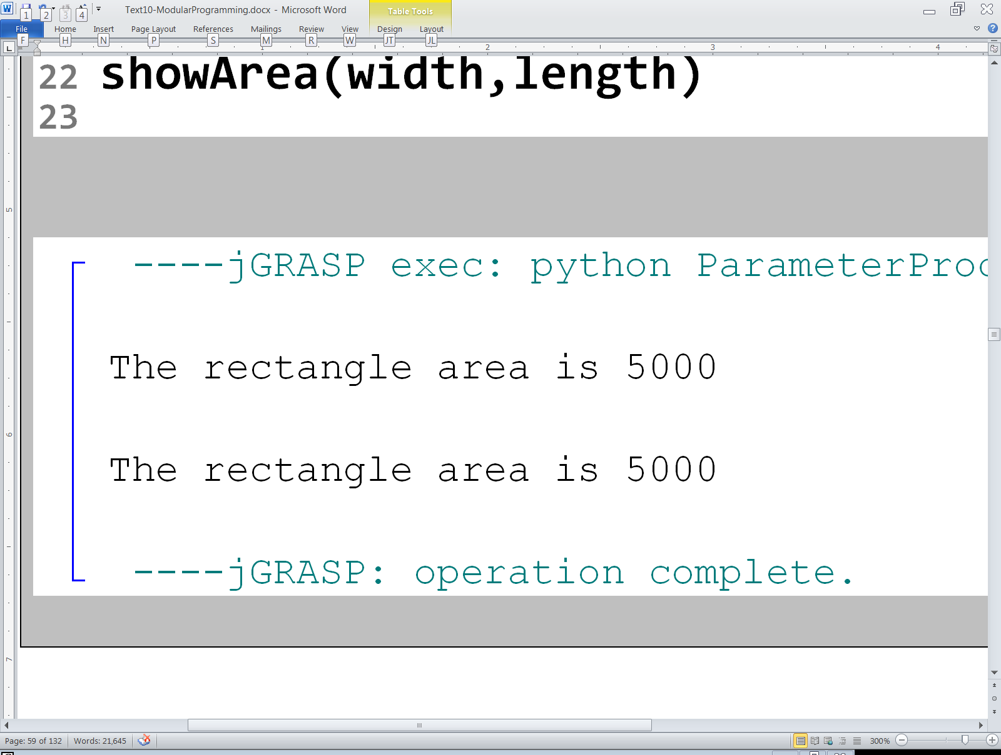

Slide 17
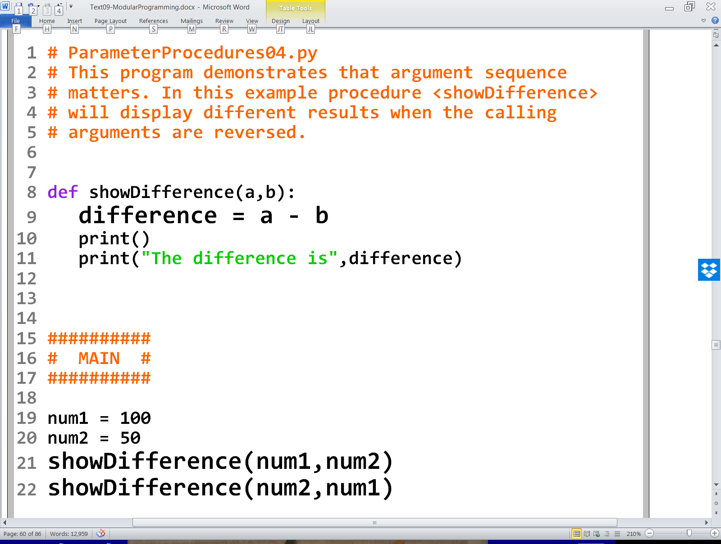

Slide 18
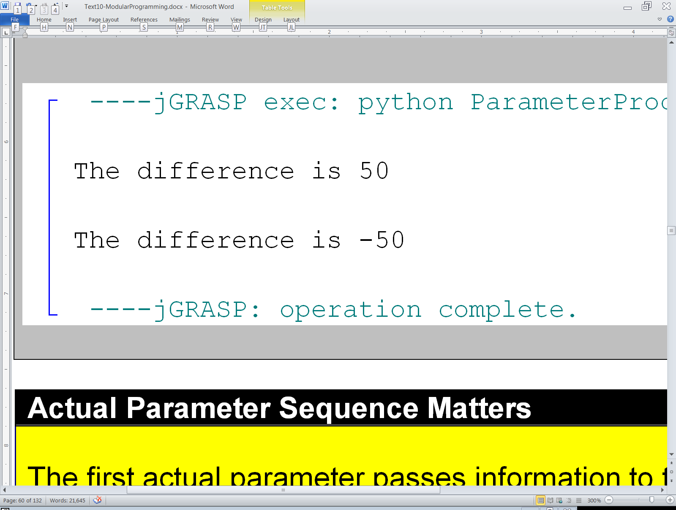
100 50
-50 -100
50 -50

Slide 19
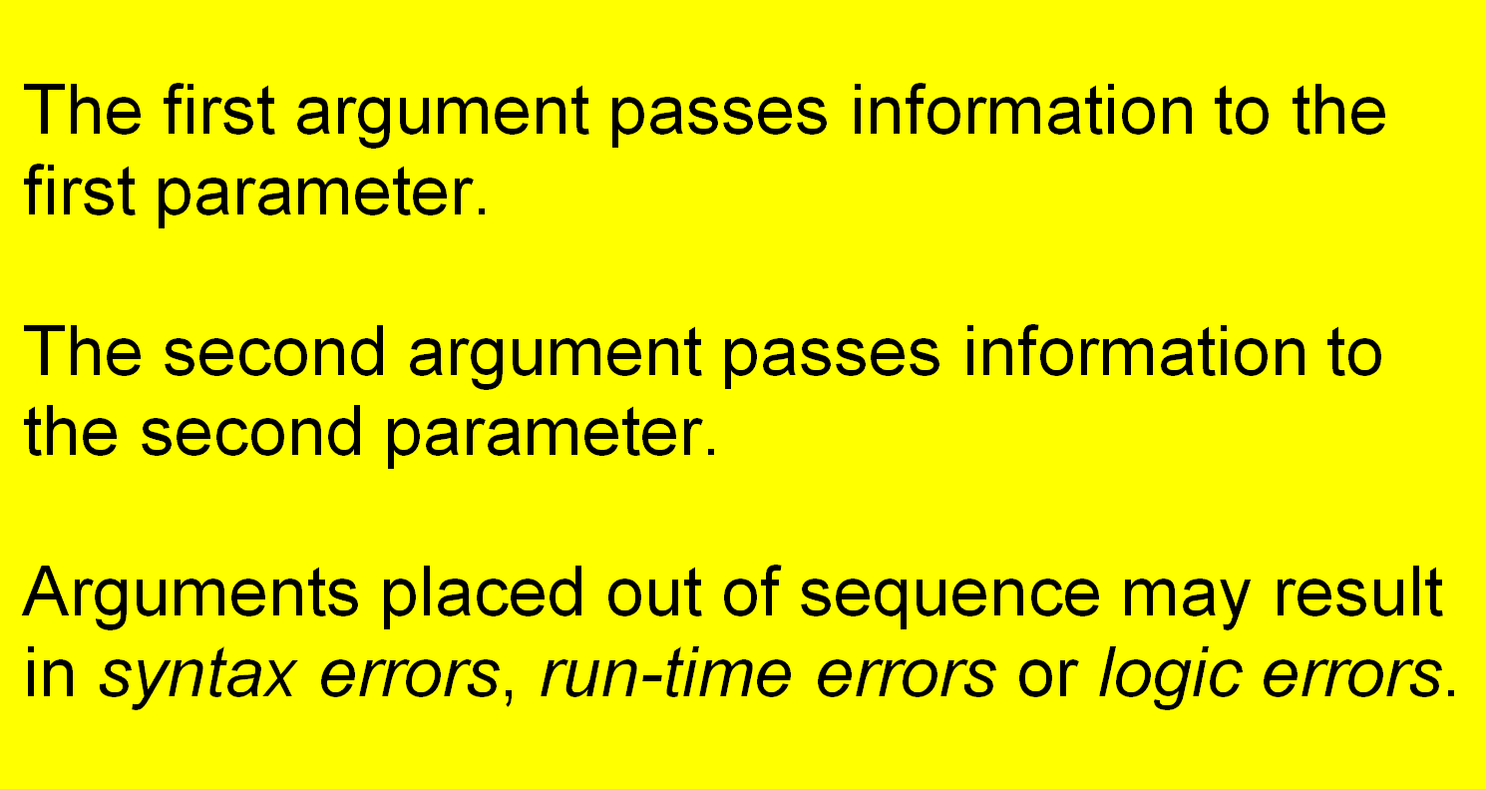
Argument Sequence Matters

Slide 20
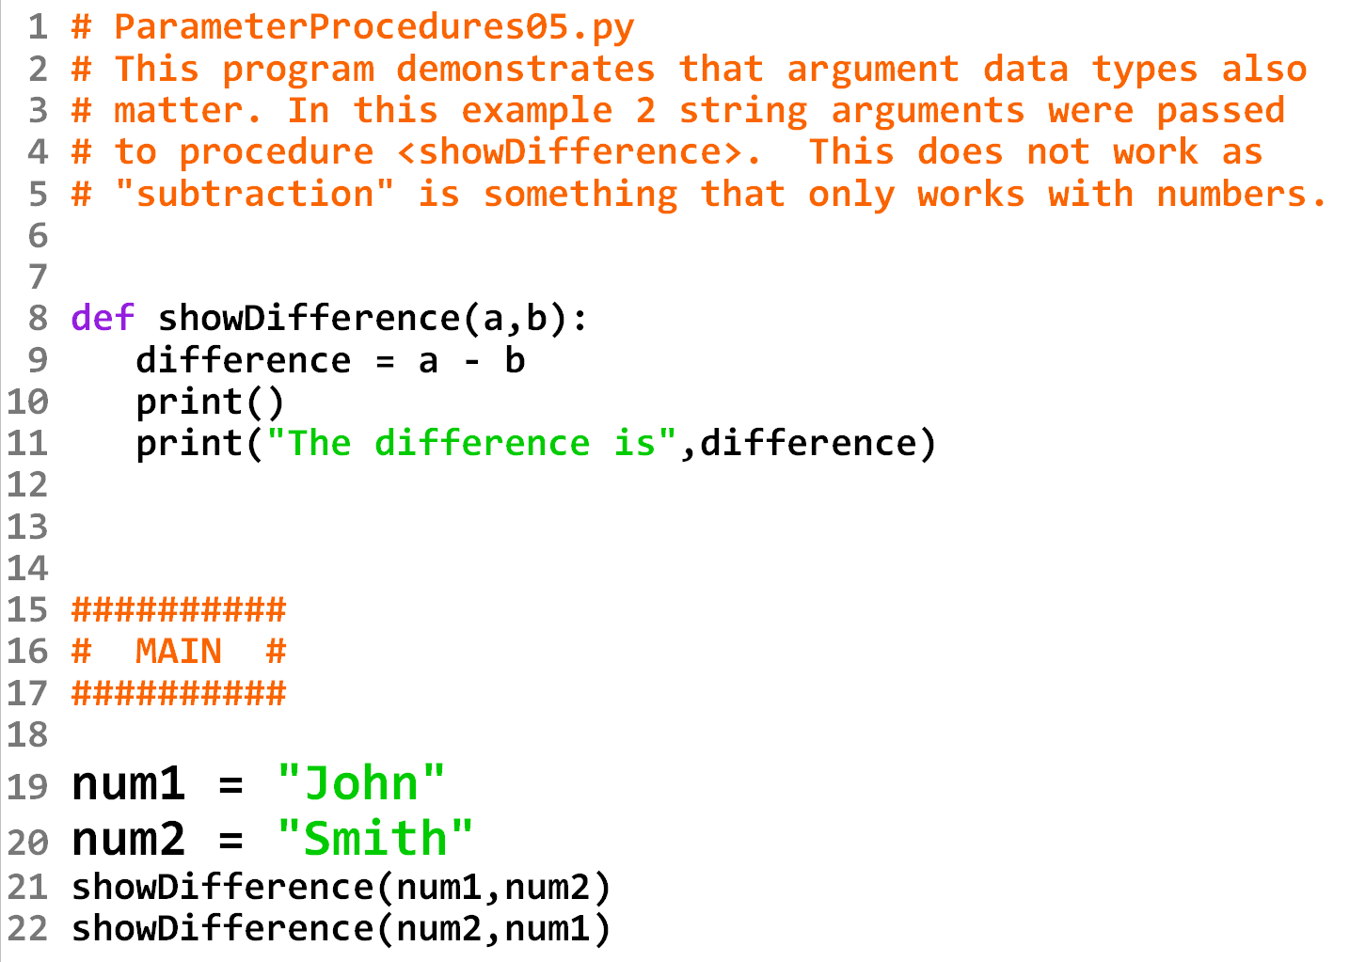

Slide 21
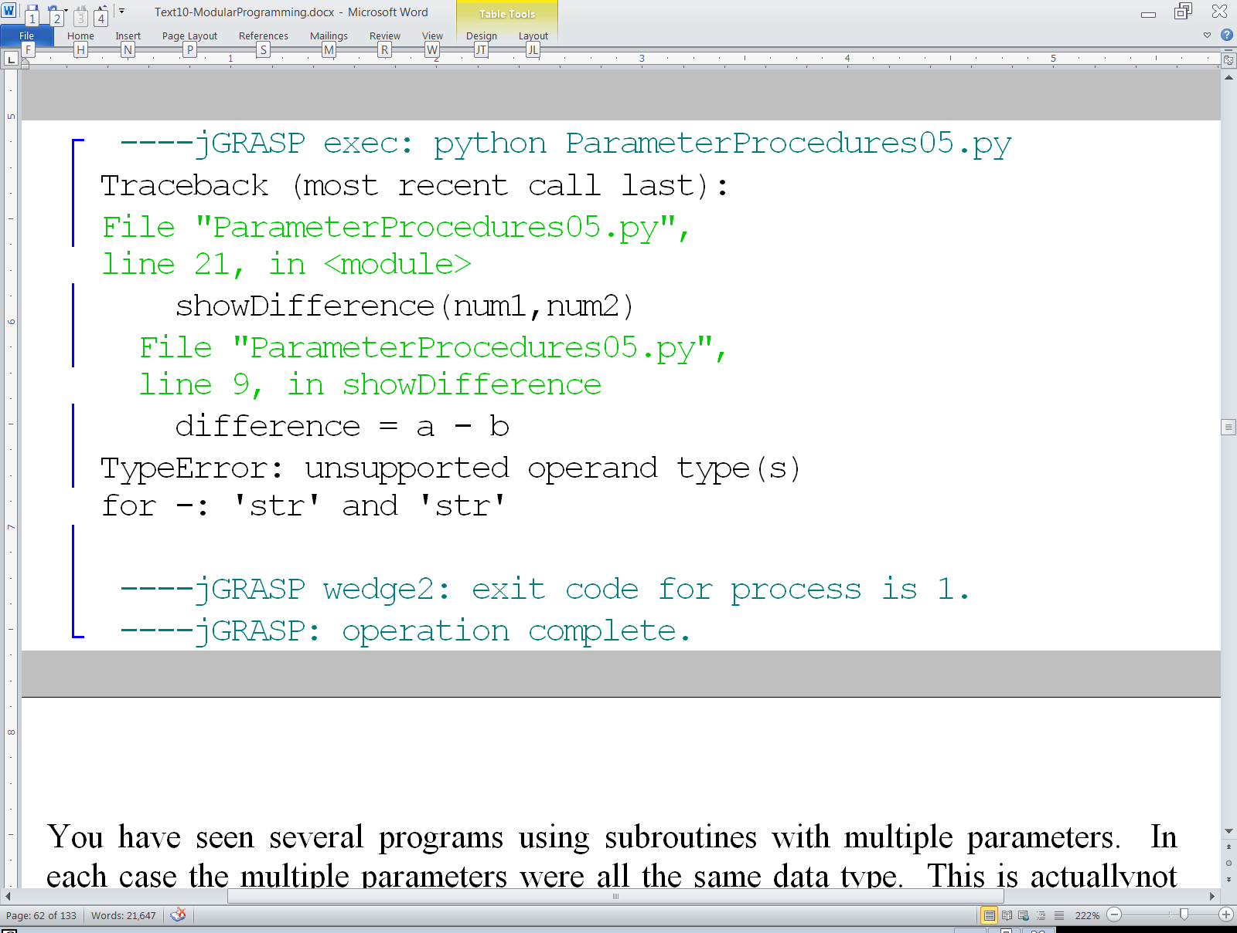

Slide 22
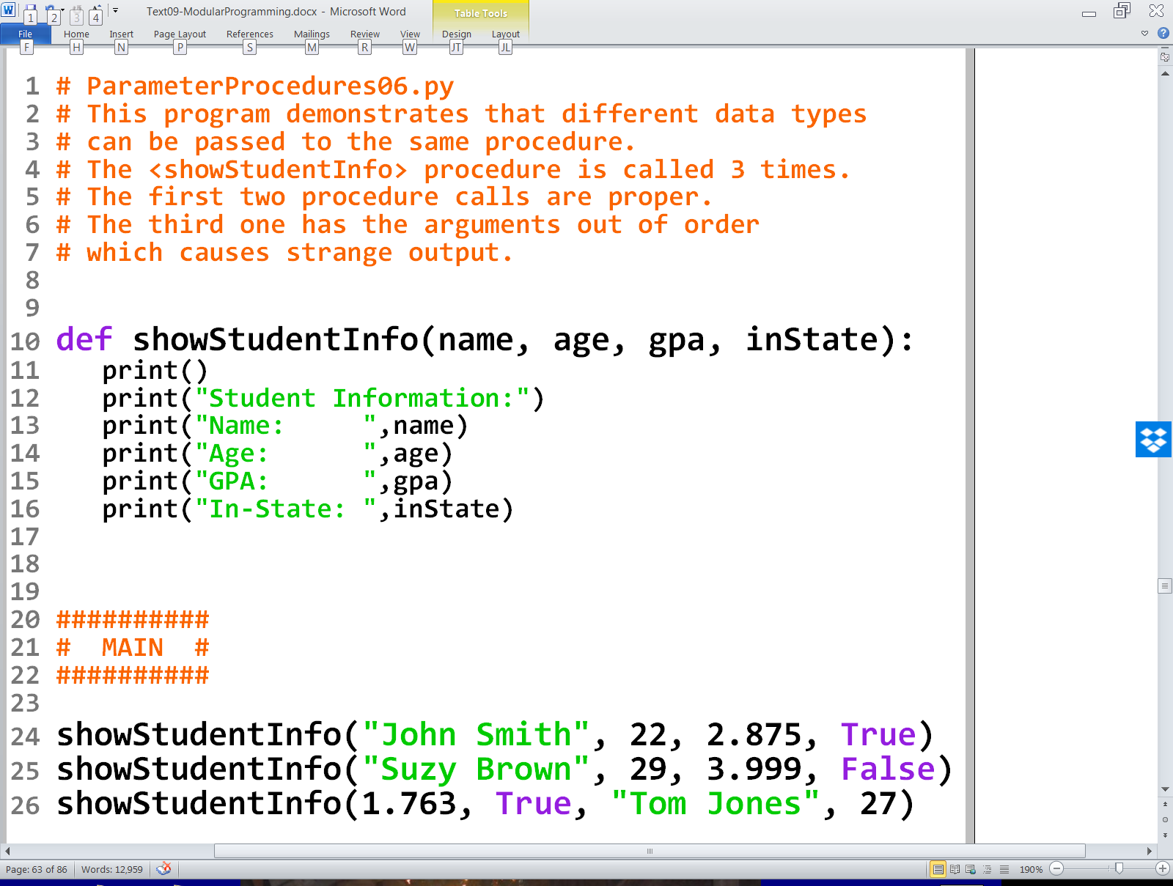

Slide 23
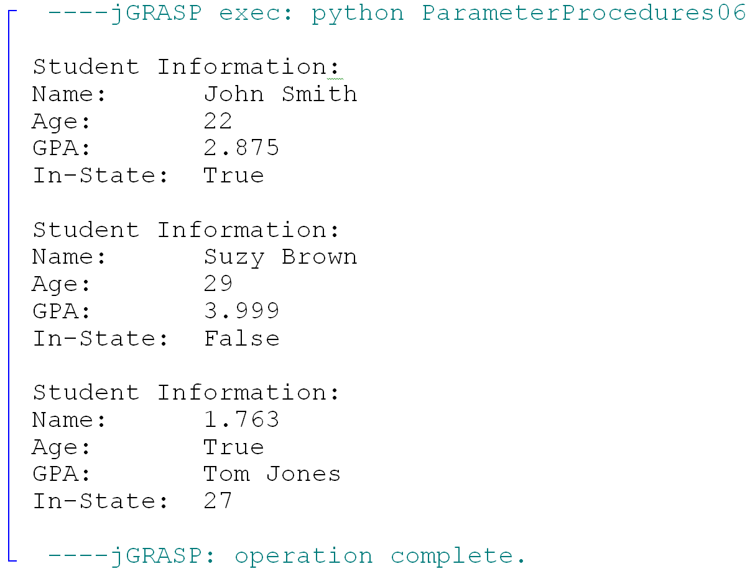

Slide 24
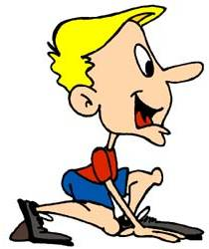

The Track Relay Analogy – Race 1
US | US
GB | GB
FR | FR
NL
The second runner from the Netherlands is missing.
The number of arguments and parameters do not match.

Slide 25
The Track Relay Analogy – Race 2
US | US
GB | GB
FR | NL
NL | FR
The second runners from the Netherlands and France are in the wrong lane. The parameters are not in the same order as the arguments. They must correspond.

Slide 26


The Track Relay Analogy – Race 3
US (John) | US (Greg)
GB (Charles) | GB (William)
FR (Gerald) | FR (Louis)
NL (Hans) | NL (Hans)
The runners are in proper staring position.
The parameters correspond.
The fact that there are 2 people from the Netherlands
with the same name is not a problem.

Slide 27
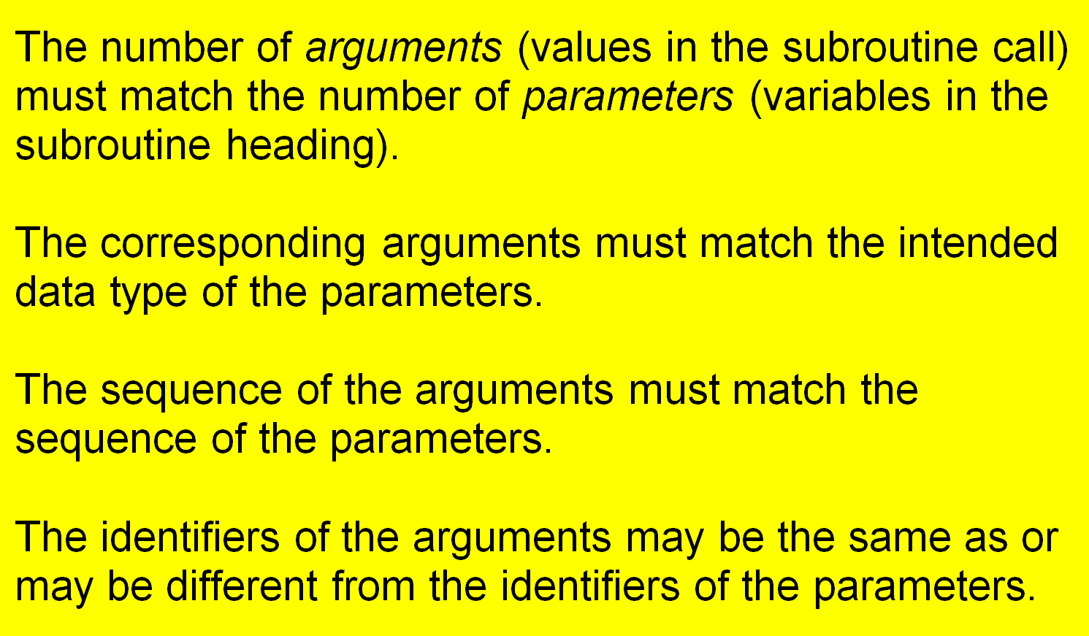
Important Rules About Using Subroutines with Parameters

Slide 28
Section 9.9
Functions with a
Single Parameter

Slide 29
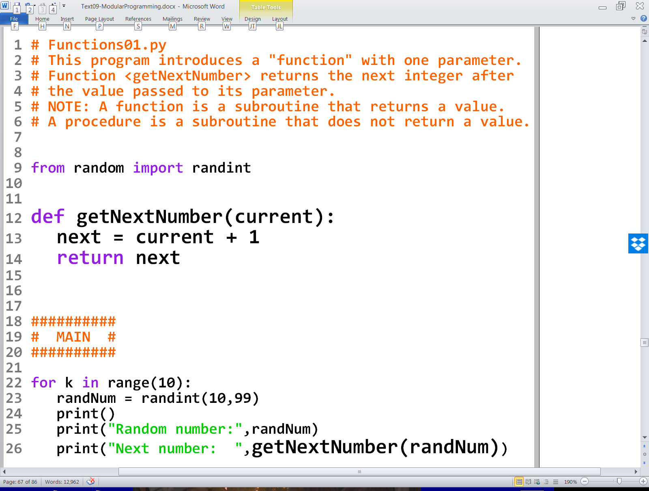

Slide 30
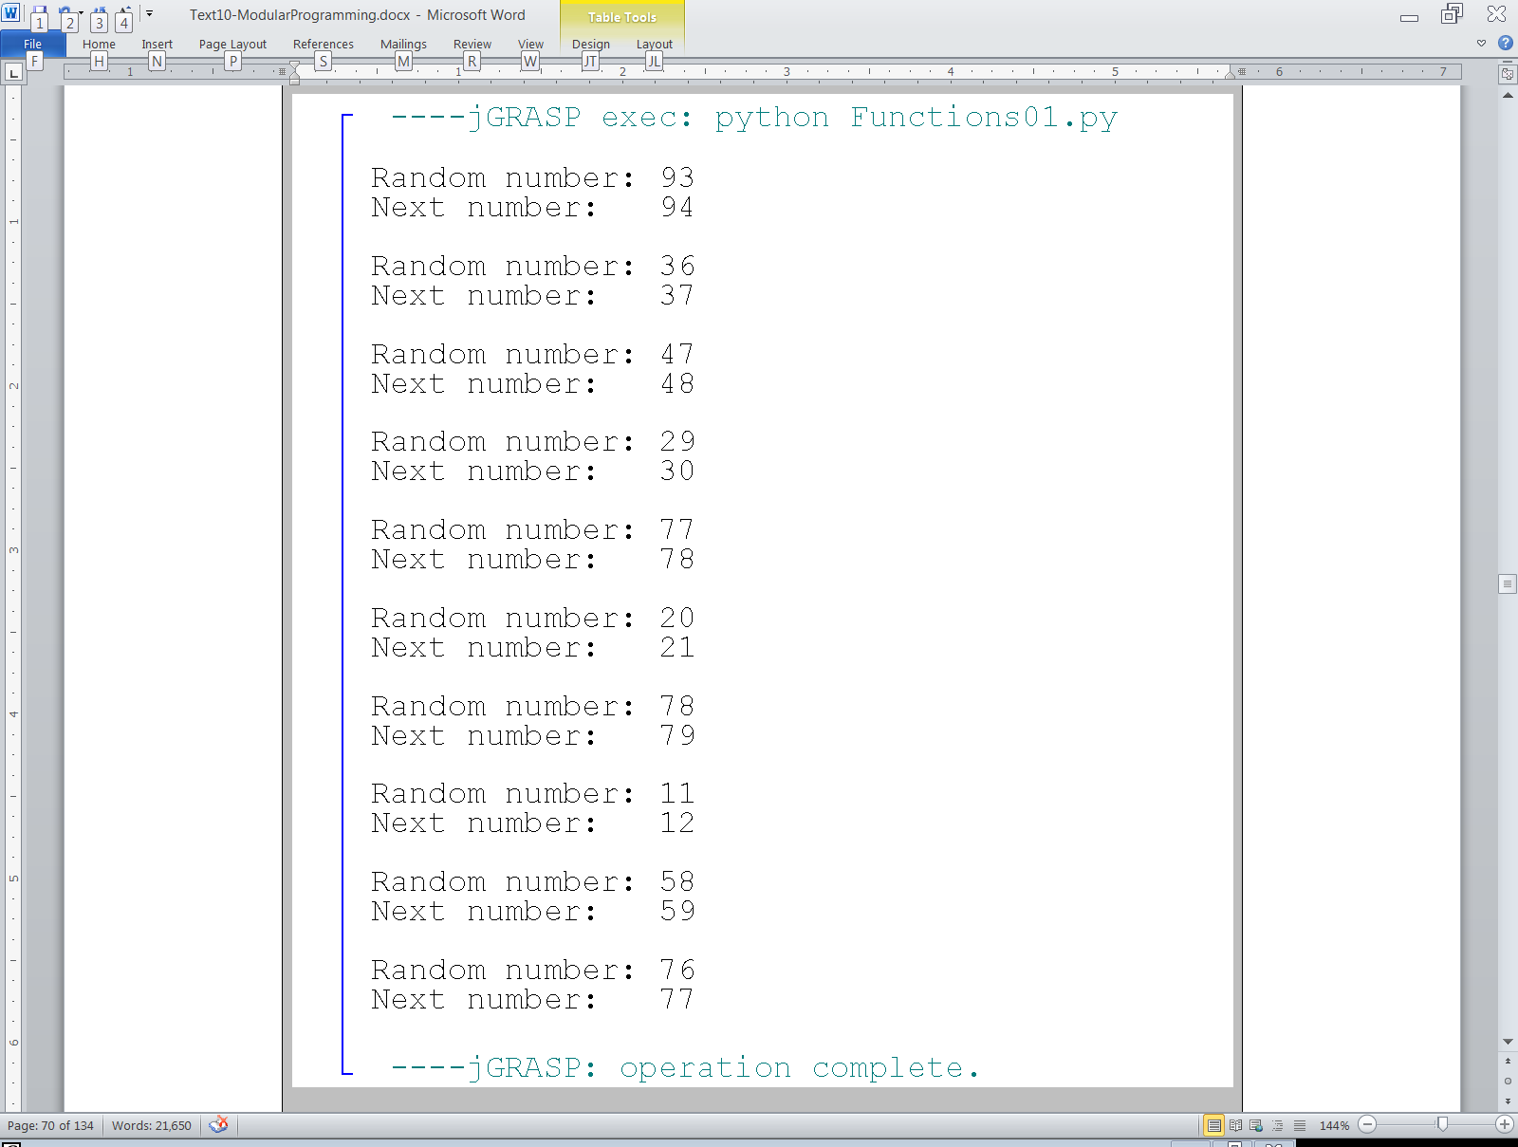

Slide 31
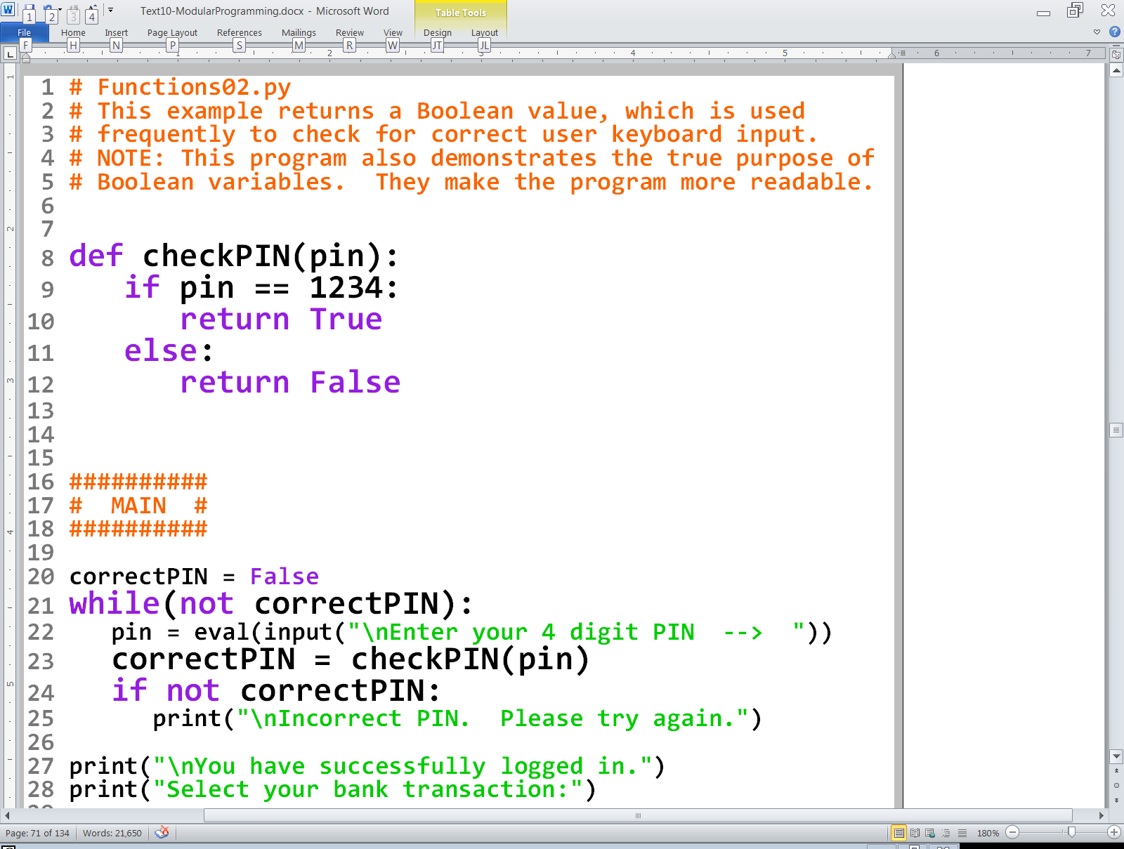

Slide 32
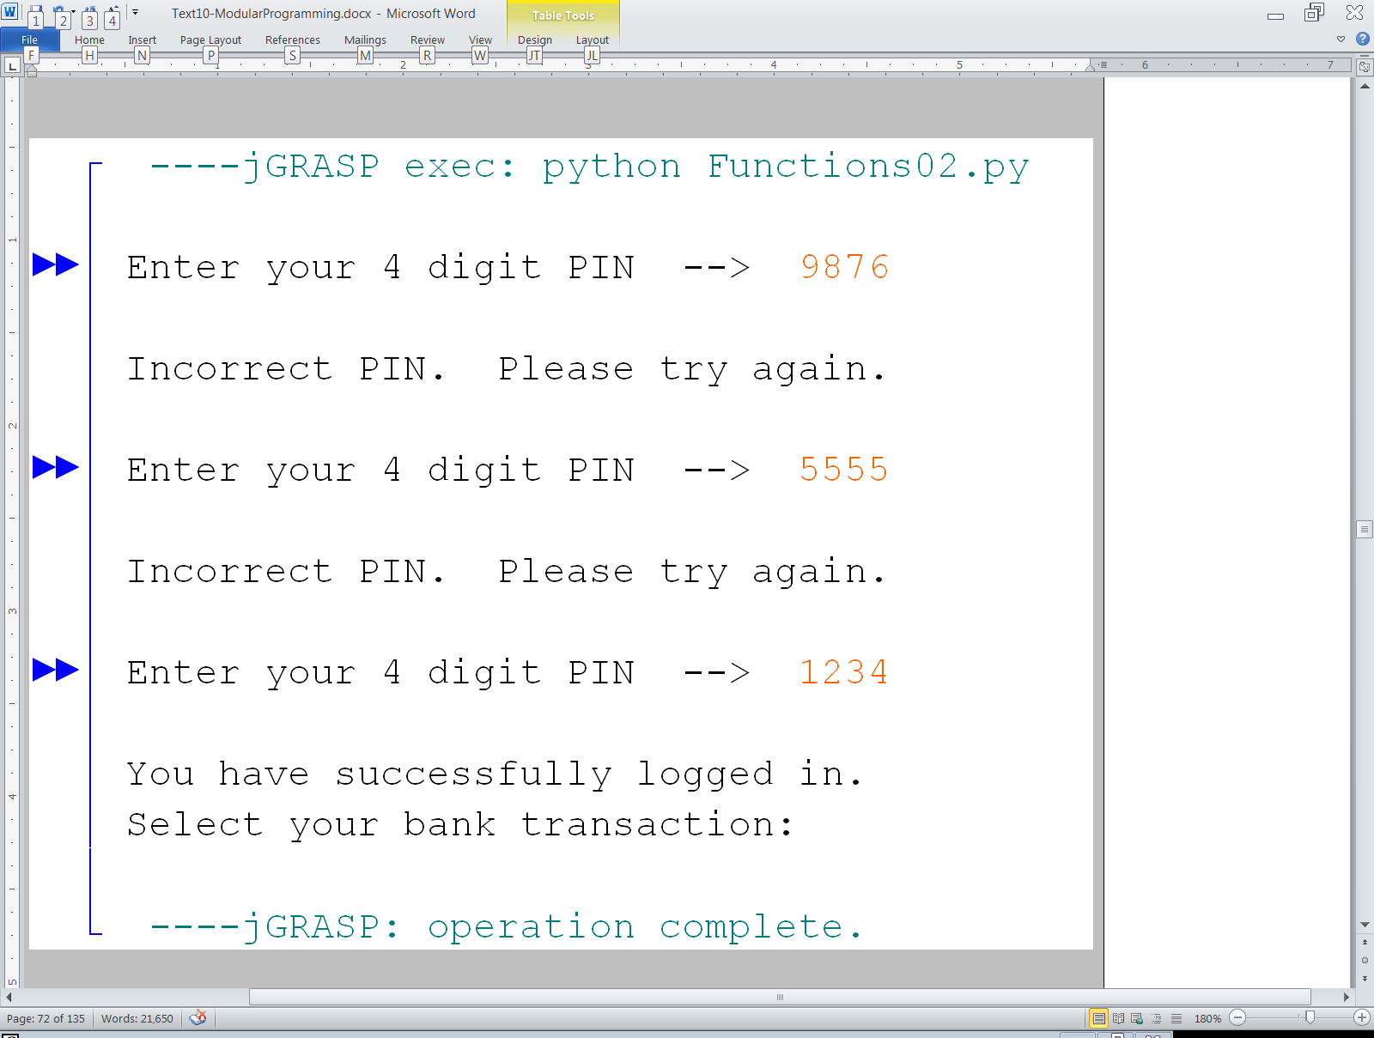

Slide 33
Section 9.10
Functions with
Multiple Parameters

Slide 34
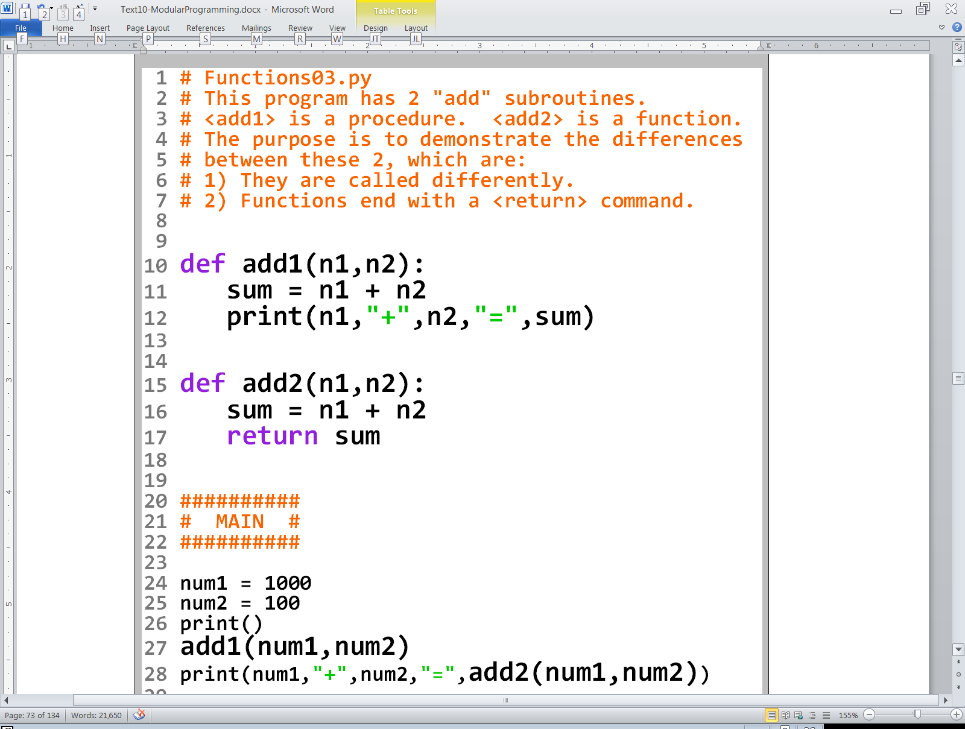

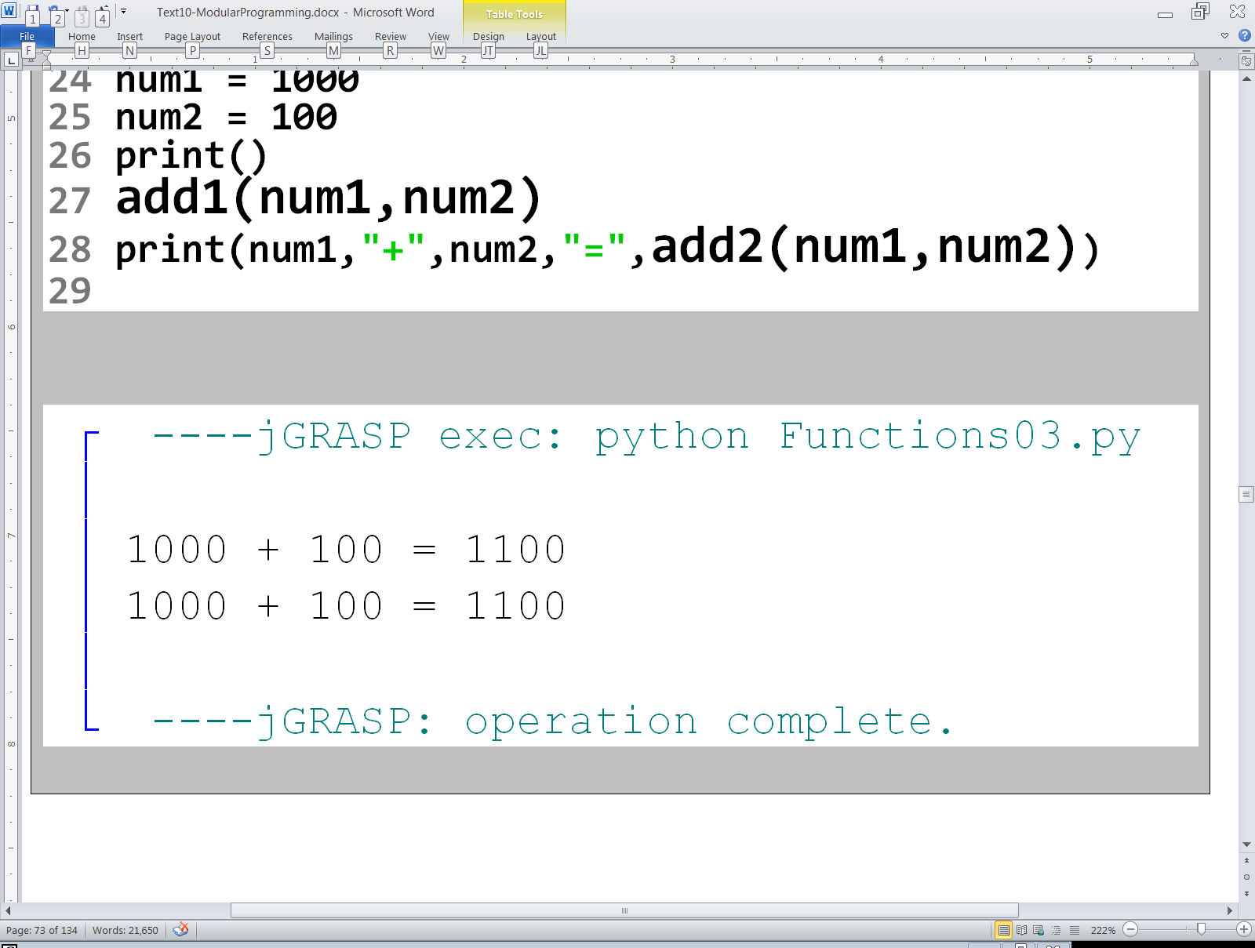

Slide 35
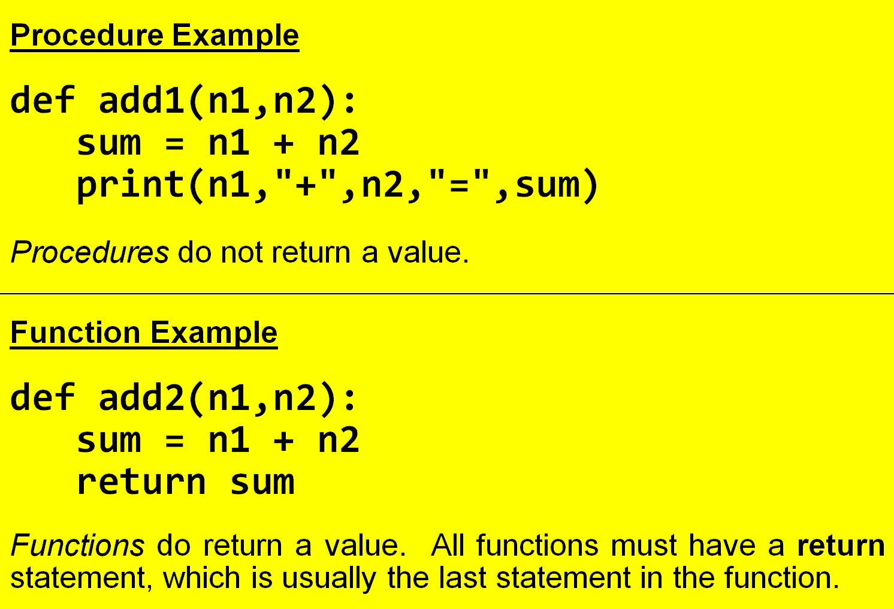
Procedures and Functions

Slide 36
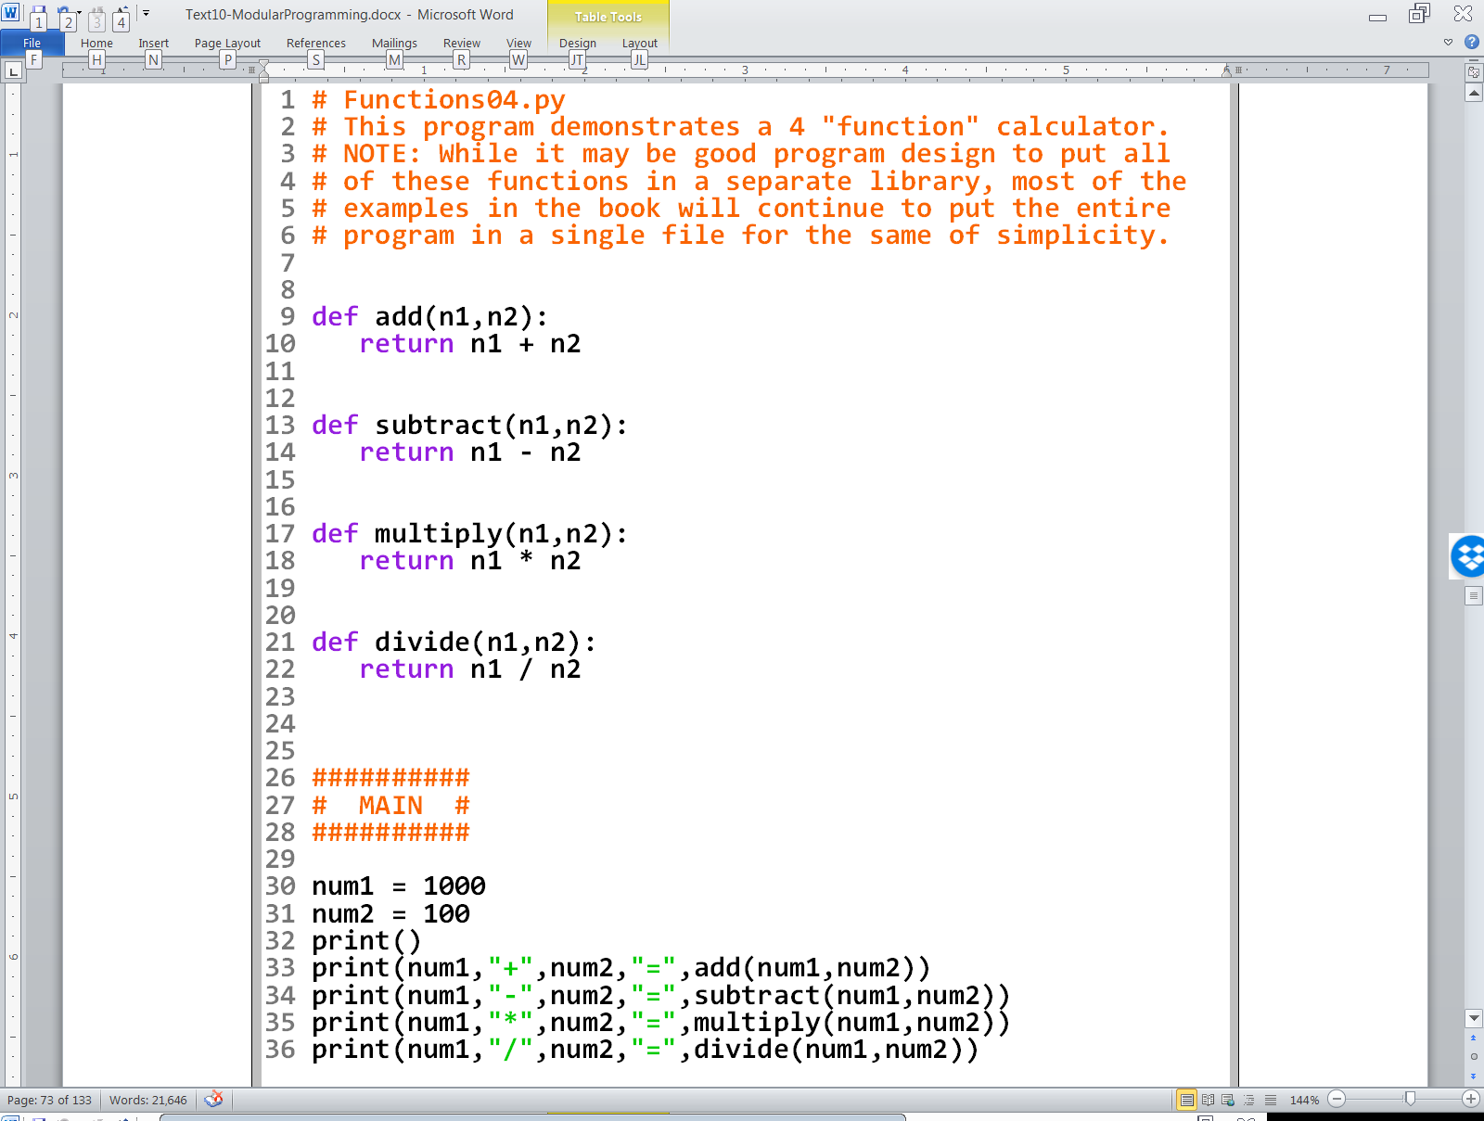
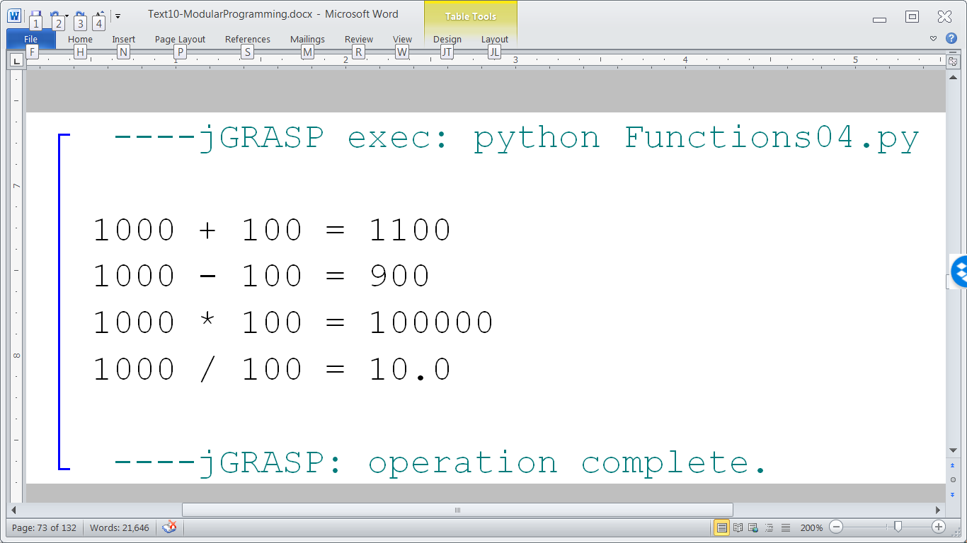

Slide 37
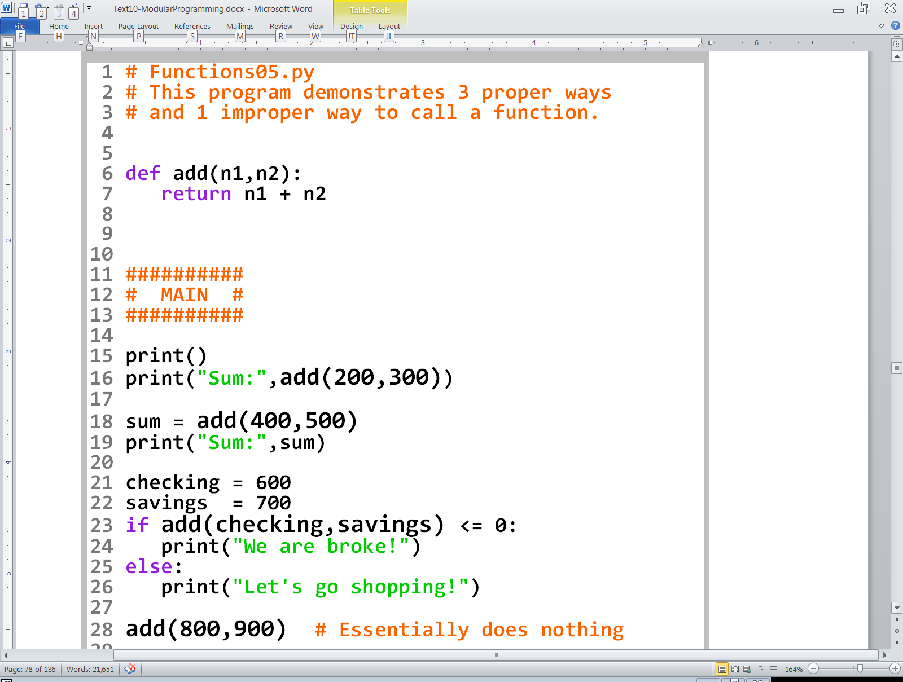
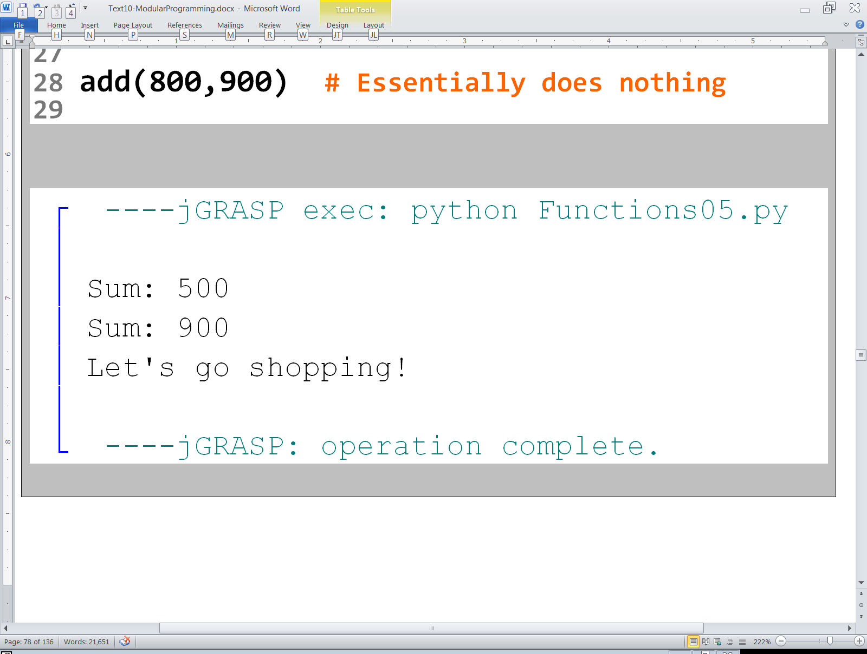

Slide 38
Section 9.11
Creating Subroutines
from Other Subroutines

Slide 39
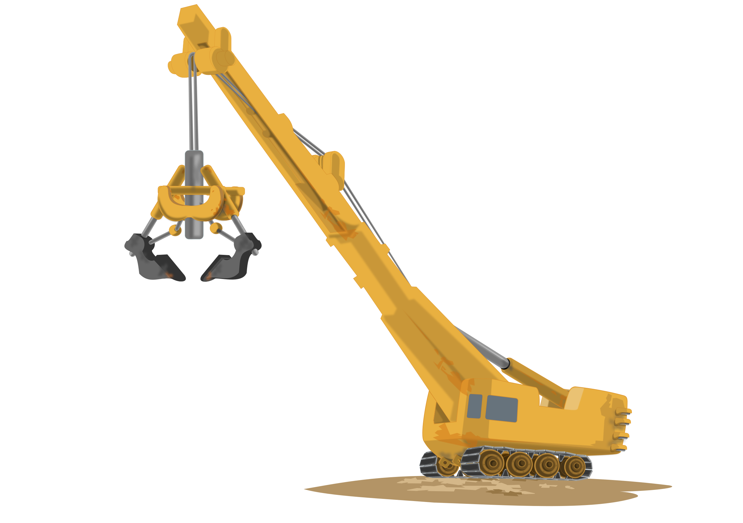
Bigger Tools & Bigger Stuff
Consider the Tool
analogy again. Essentially, we make tools
so that we can make the
stuff we want.
What if we use some
tools to make a
bigger tool, like
a crane?
Now we can make bigger stuff,
like a car or even a building.
Once subroutines are created,
they can be used to create bigger,
more powerful subroutines.

Slide 40
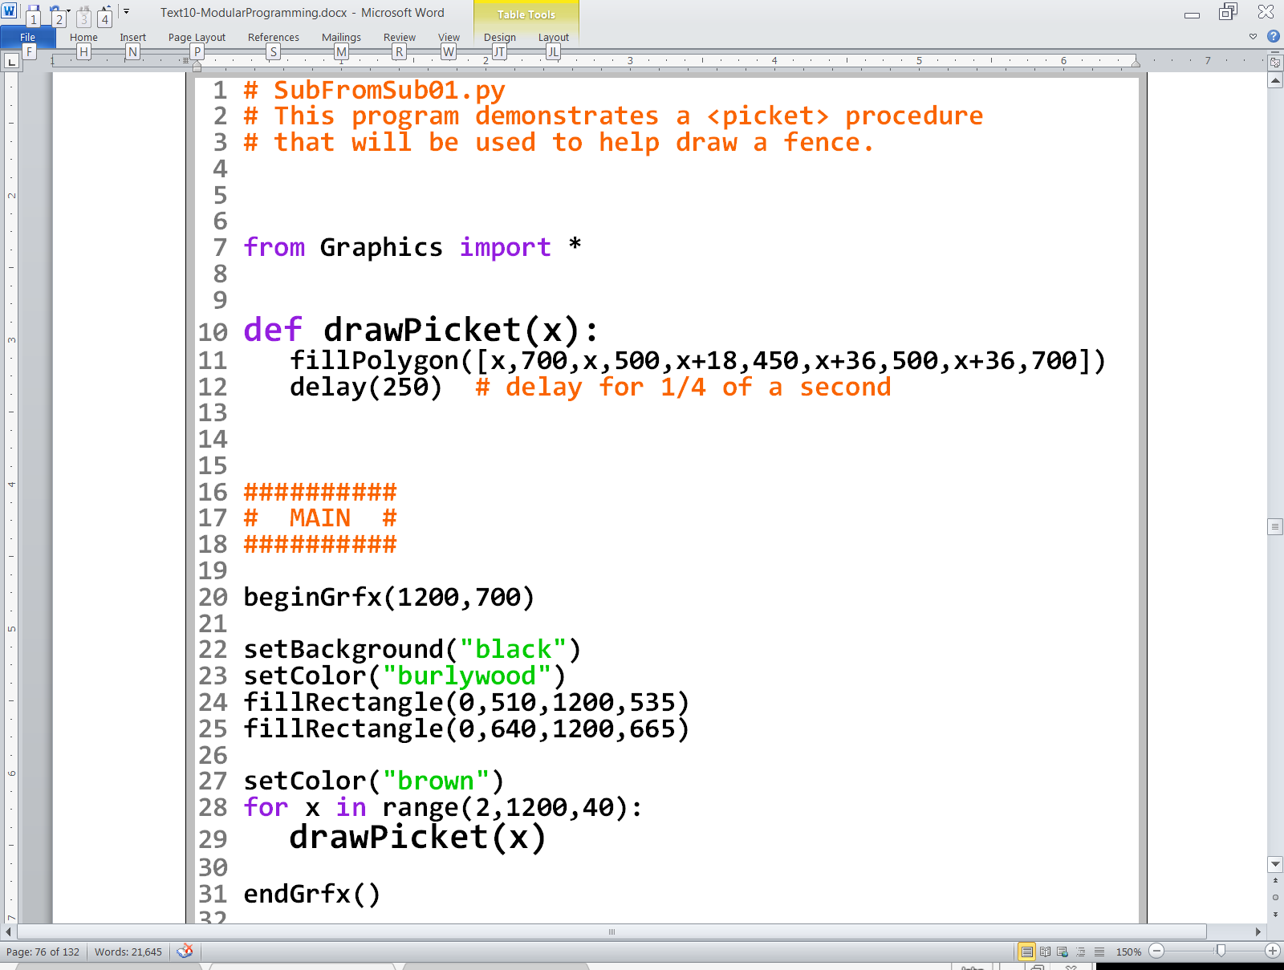

Slide 41
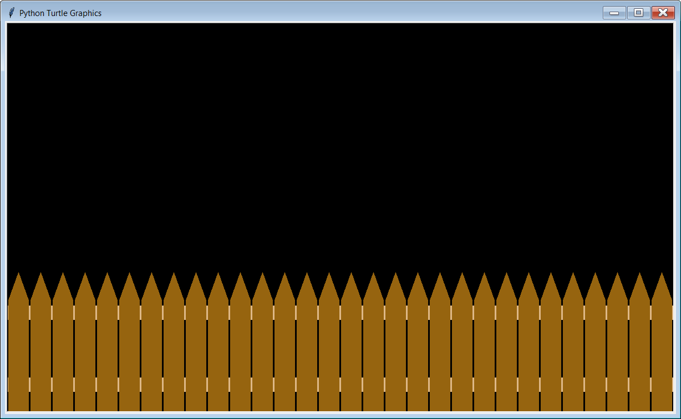

Slide 42
NOTE:
These pickets are actually drawn
one at a time with a ¼ second delay
between each picket. To see this effect
execute the program on your computer.

Slide 43
The Logic of drawPicket
drawPicket(x)
x is the horizontal value of the bottom left corner of the picket.
The y (vertical) value of the bottom left corner is always 700 since all pickets will be at the bottom of the graphics window.
The other 4 coordinates of the picket are relative to the point (x,700).
x+18,450
x,500
x+36,500
x,700
x+36,700

Slide 44
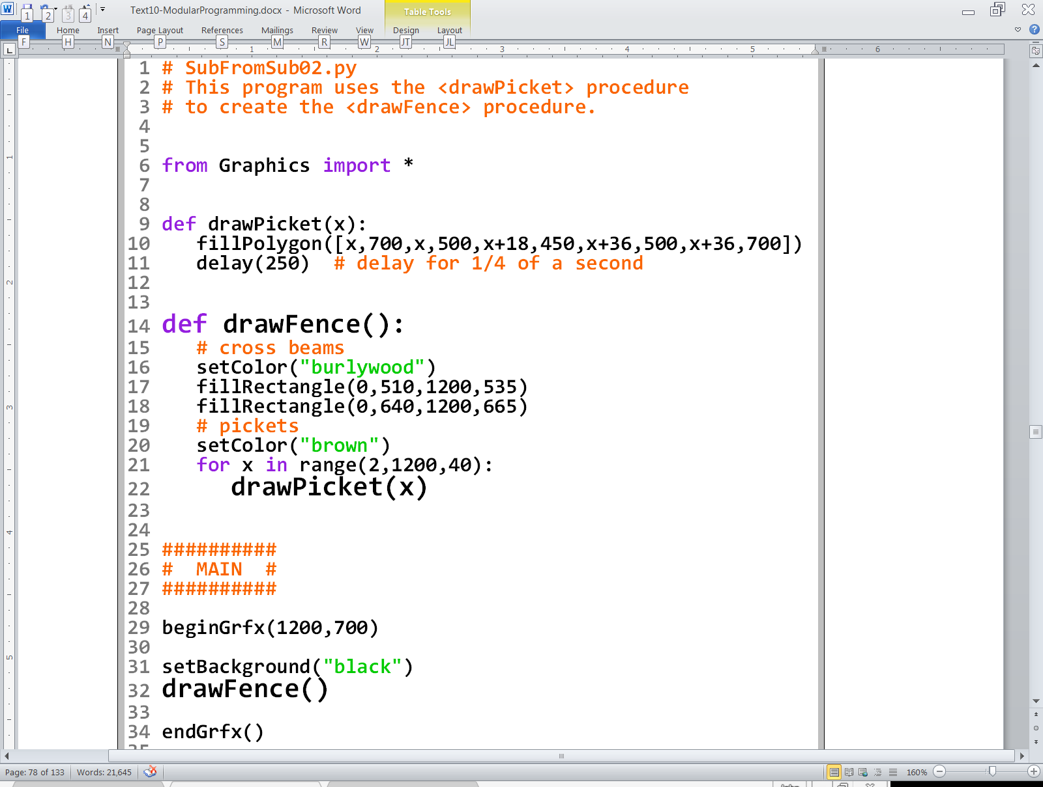

Slide 45
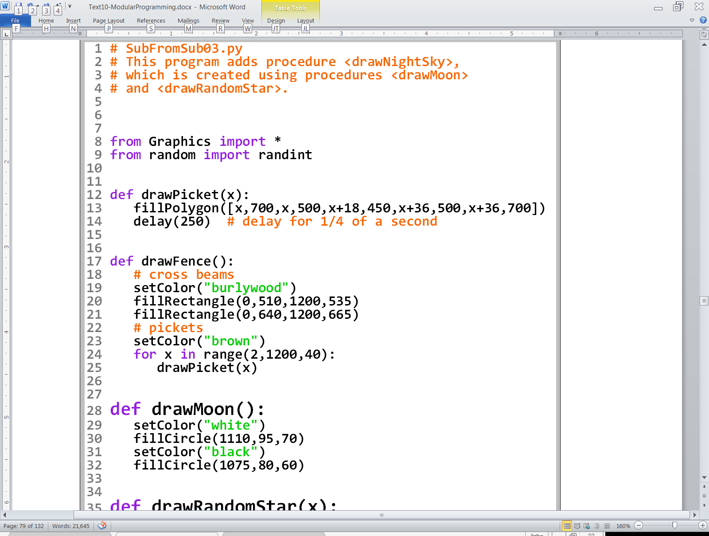
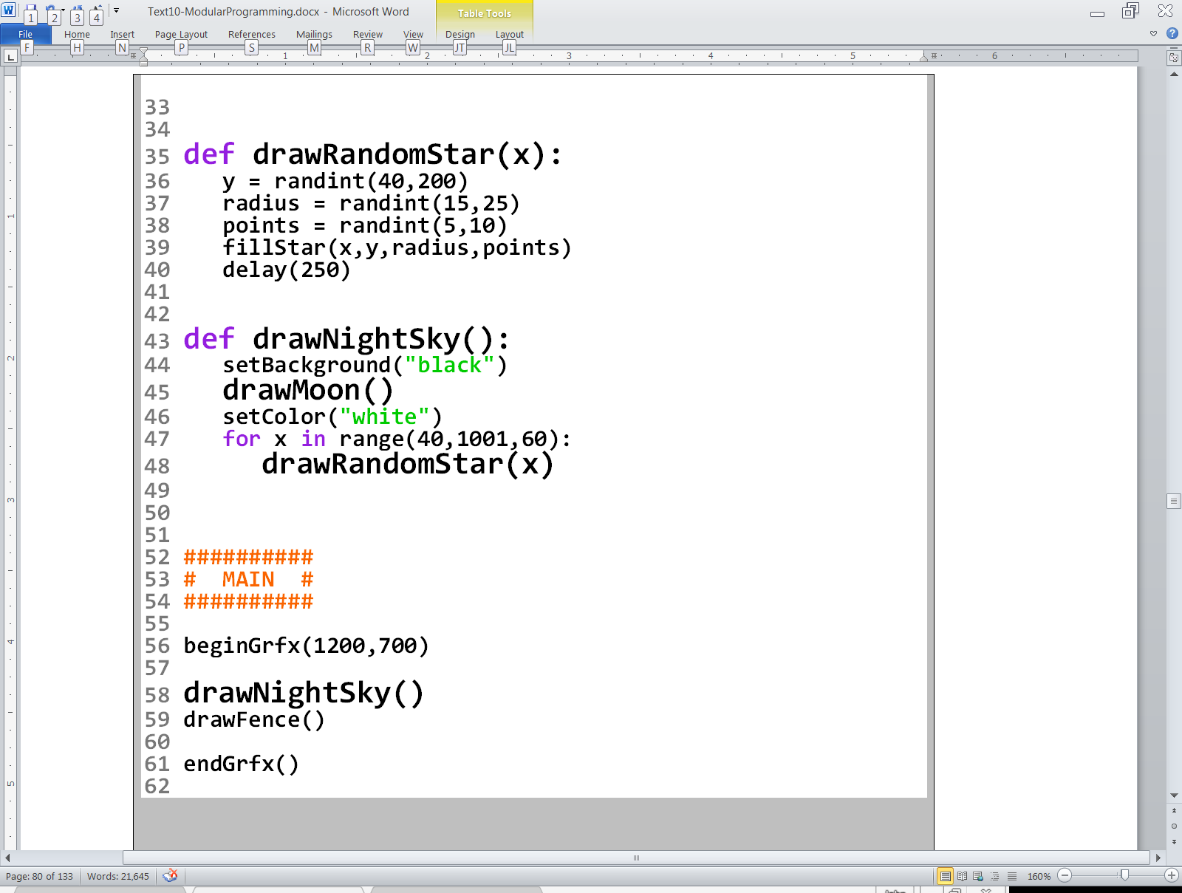

Slide 46
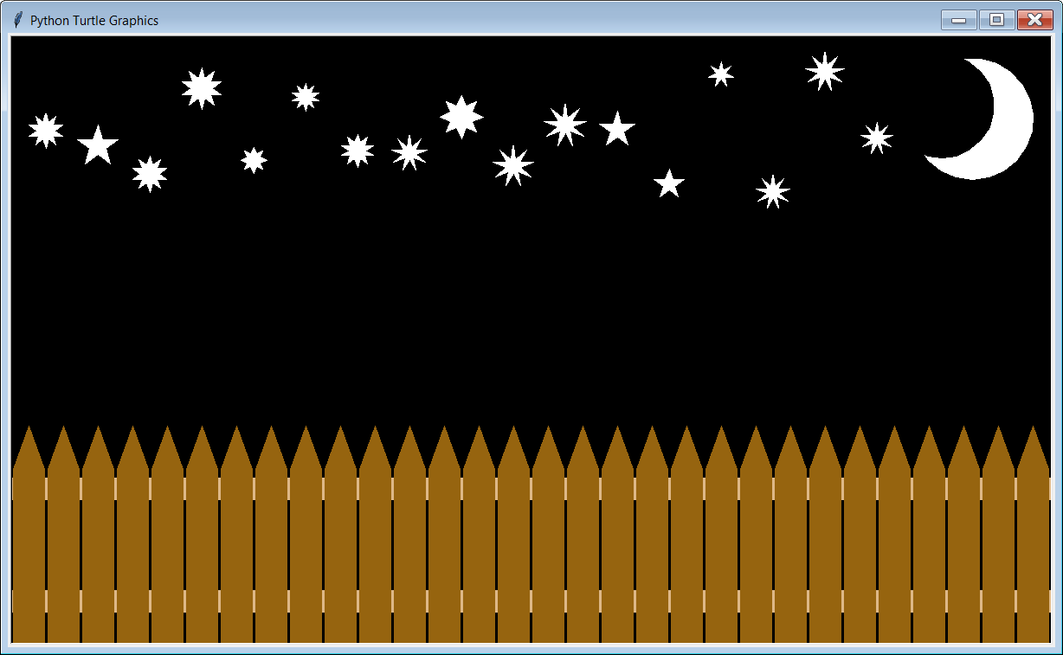

Slide 47
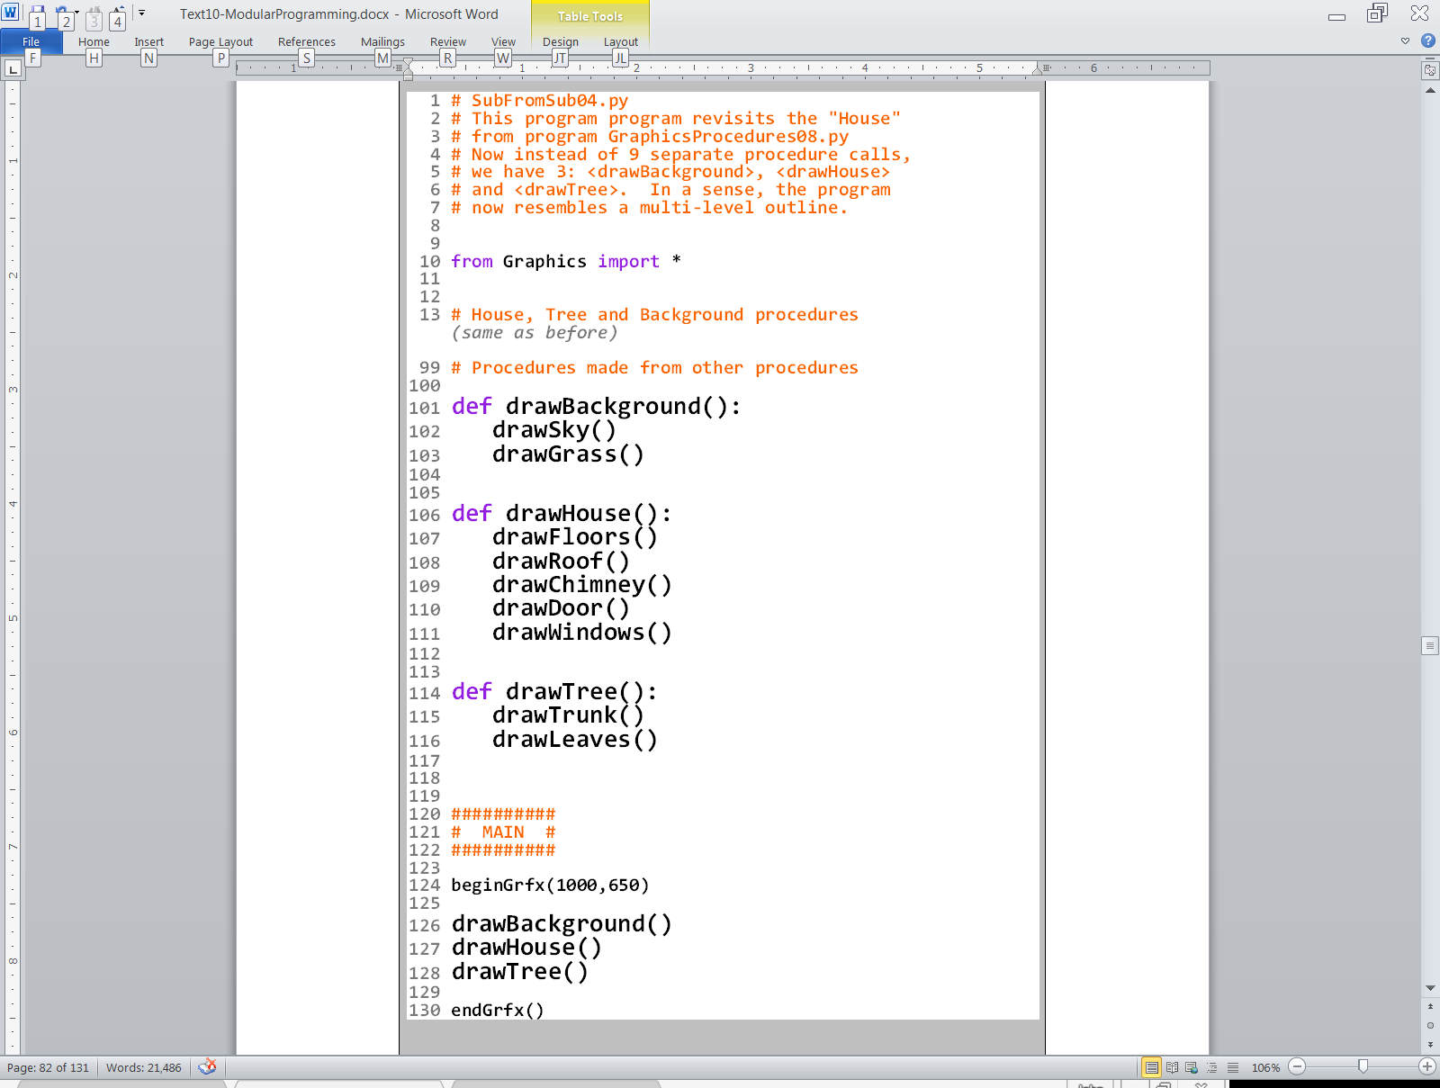
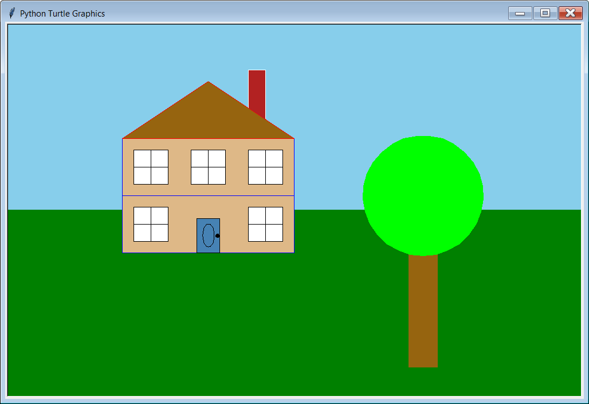

Slide 48
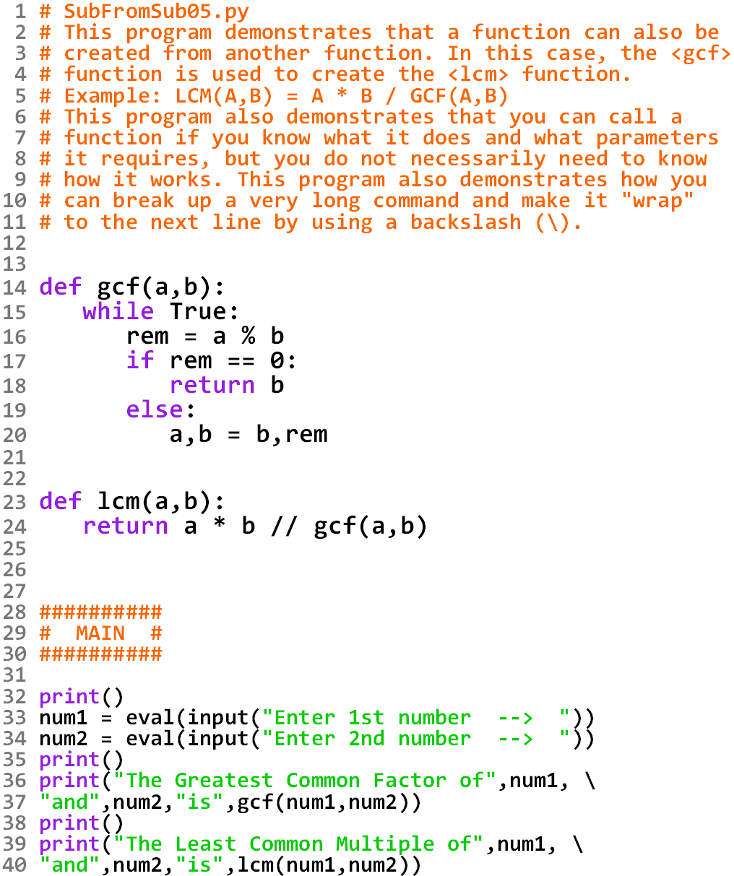

Slide 49
